Slide 1
Directional Gradient Coherence (DGC) Metric
An Approach to PVD Steganography Detection
Course: BCSE403L - A2
Prof. Dr. Geetha S.
Mithun Balaji V (22BCE5189) Mitra Vinda M. (21BCE5665)
Dakshini S (22BCE1003)

Slide 2
Introduction
We propose the Directional Gradient Coherence (DGC) metric, a novel block‑wise measure of gradient orientation dispersion weighted by energy, to detect PVD steganography. By computing DGC on raw and denoised wavelet detail subbands and fusing scores relative to empirical medians, our interactive prototype yields 0–100 +% likelihoods with intuitive visualizations, boosting detection sensitivity and forensic insight.

Slide 3
Problem Statement
Pixel Value Differencing steganography adaptively embeds data in high‑variance regions, leaving subtle alterations in image detail that evade existing detectors. Traditional gradient- or statistical-based approaches lack sensitivity to angular disruptions in edge flow, leading to false negatives.
Our research addresses this gap by introducing the DGC metric to quantify orientation dispersion in wavelet detail, enhancing detection of PVD interference.

Slide 4
Research Objectives
Formalize the DGC Metric: Precisely define the block‑wise Directional Gradient Coherence measure, derive its mathematical properties (e.g. range, behavior under pure edge fields), and analyze its computational complexity.
Integrate with Wavelet Detail Extraction: Build a hybrid framework that isolates high‑frequency detail via single‑level DWT, computes DGC on both raw and denoised subbands, and fuses these into a unified detection score.
Analyze Parameter Sensitivity & Robustness: Perform ablation studies to assess how block size, DGC exponents, gradient thresholds, and denoising parameters affect detection signals.
Deliver an Interactive Prototype: Develop an app that visualizes raw vs. denoised detail, difference maps, and a 0–100 % likelihood scale.

Slide 5
Proposed System
The proposed system applies a single‑level discrete wavelet transform to extract high‑frequency image details and denoise them via bilateral filtering. It then computes the novel Directional Gradient Coherence (DGC) metric block‑wise on both raw and smoothed detail images, and fuses these scores into a unified detection statistic. An interface app presents original and denoised images, difference maps, and a 0–100 % stego‑likelihood scale, with interactive parameter controls for forensic analysis.

Slide 6
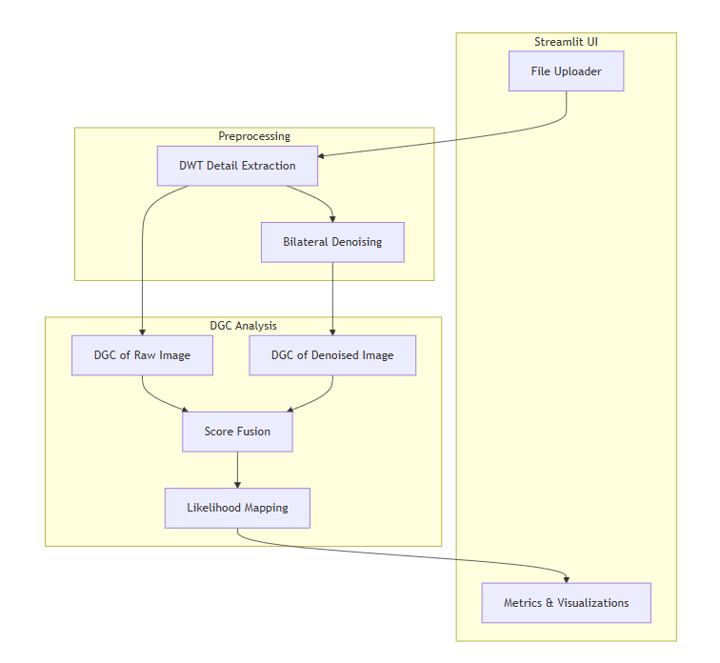
Proposed System - System Diagram

Slide 7
Streamlit App Modules
Module | Purpose | Key Functions/Components
Streamlit App (User Interface) | Handle user interaction and layout | st.file_uploader, st.columns, st.image, st.markdown, st.pyplot
Wavelet Analysis | Extract high‑frequency detail subbands via DWT | get_wavelet_detail_image (uses pywt.dwt2)
Denoising | Smooth the wavelet detail image while preserving edges | get_wavelet_denoised_image (uses cv2.bilateralFilter)
Gradient Computation | Compute per‑pixel gradient magnitude and orientation | compute_gradients (Sobel filters via OpenCV)

Slide 8
Streamlit App Modules
Module | Purpose | Key Functions/Components
DGC Computation | Measure block‑wise angular dispersion of gradients, weighted by energy | block_dgc, compute_weighted_dgc_score
Score Fusion & Mapping | Fuse raw vs. denoised DGC scores and map to 0–100 % likelihood & relative position | Raw – denoised, then linear ramp mapping with LOW_MEDIAN, HIGH_MEDIAN; clamp
Visualization | Display difference heatmap and relative‑position number line | Matplotlib plots (inferno colormap) embedded via st.pyplot

Slide 9
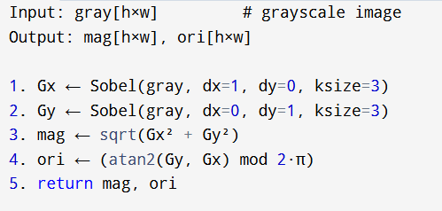
Algorithm - Step 1 - Computing the Gradients

Slide 10
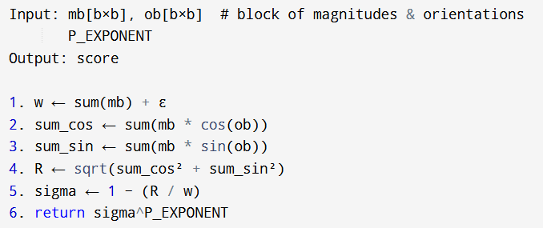
Algorithm - Step 2 - Blockwise DGC

Slide 11
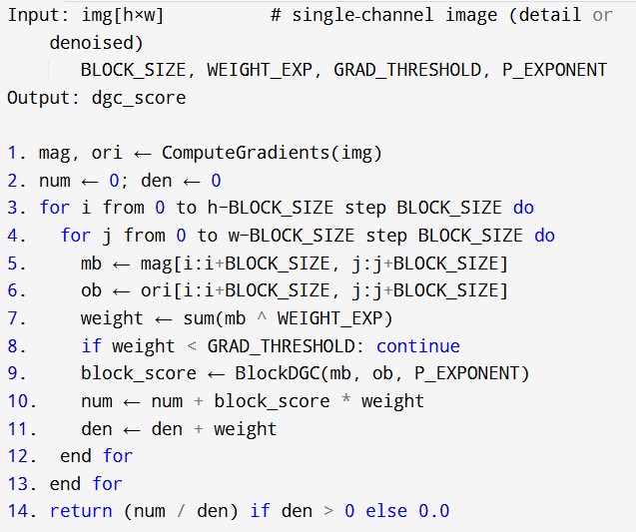
Algorithm - Step 3 - Compute Global (Weighted) DGC

Slide 12
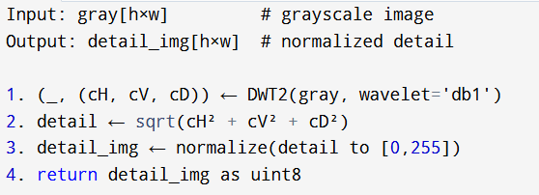
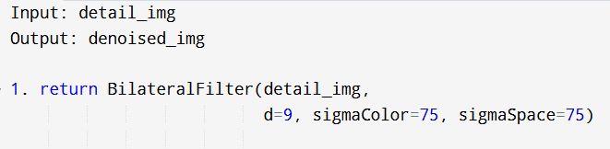
Algorithm - Step 4 - Obtain WAVELET DETAIL
Algorithm - Step 5 - Obtain Denoised Wavelet Detail

Slide 13
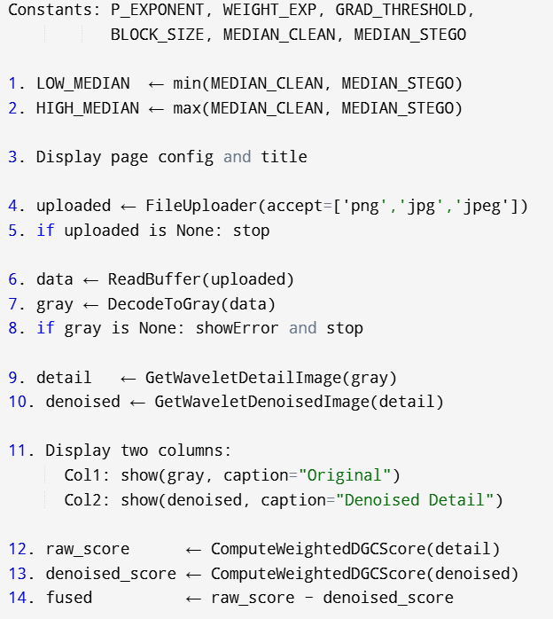
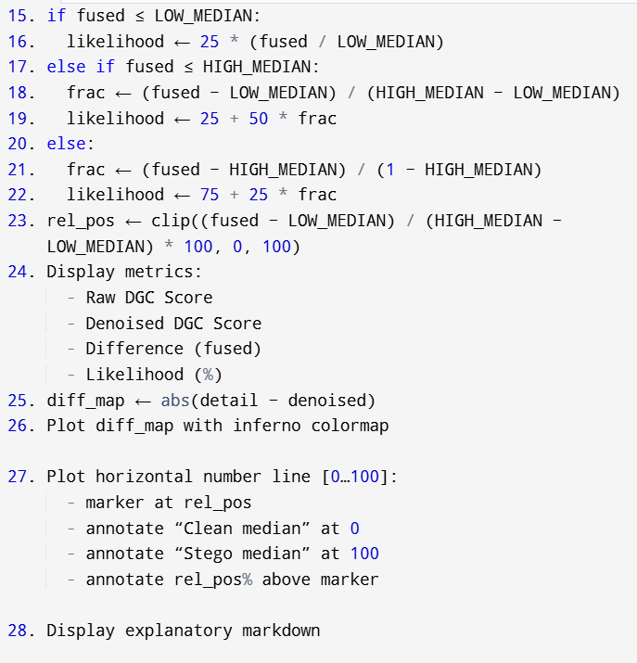
Algorithm - Step 6 - Score Fusion, Mapping, UI

Slide 14
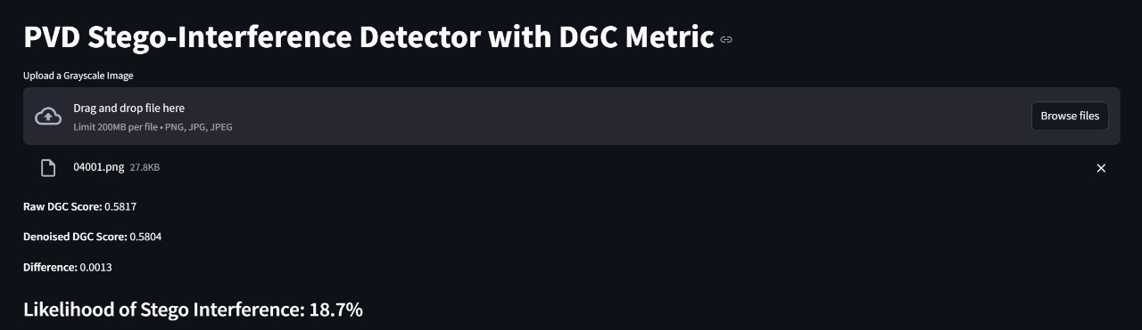
Implementation Results - Clean Image

Slide 15
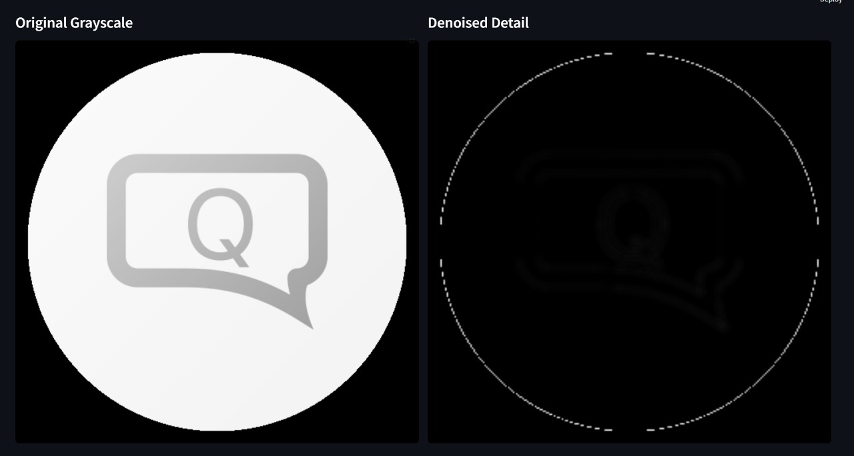
Implementation Results - Clean Image

Slide 16
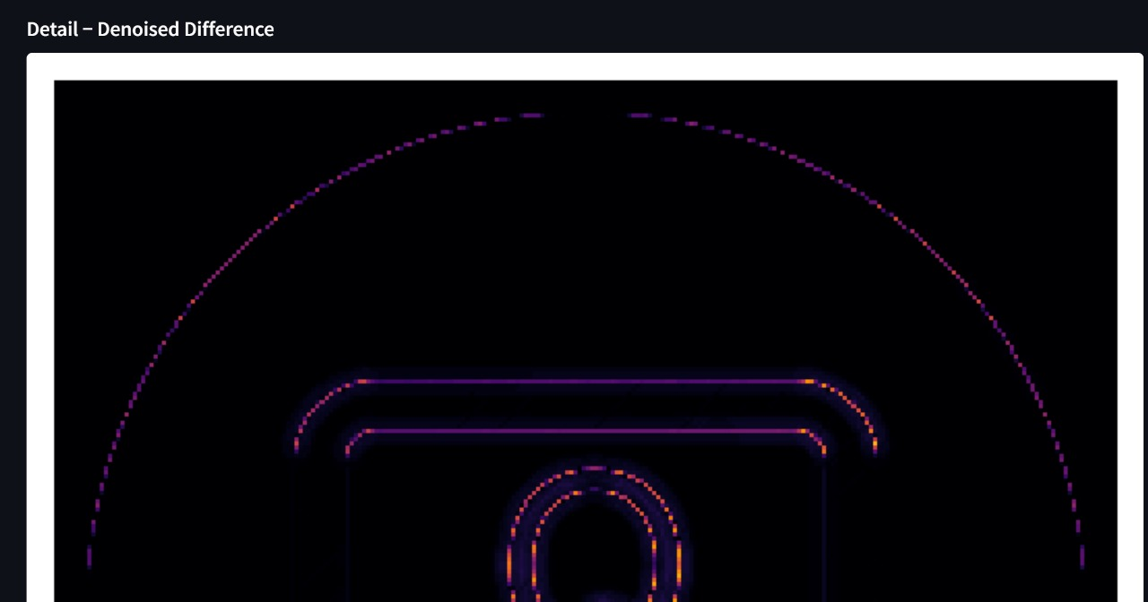
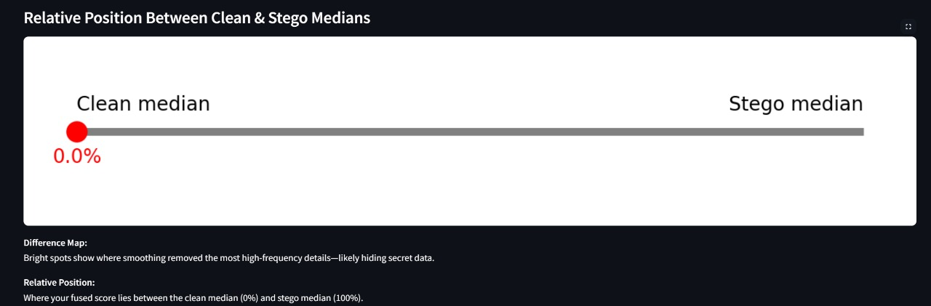
Implementation Results - Clean Image

Slide 17
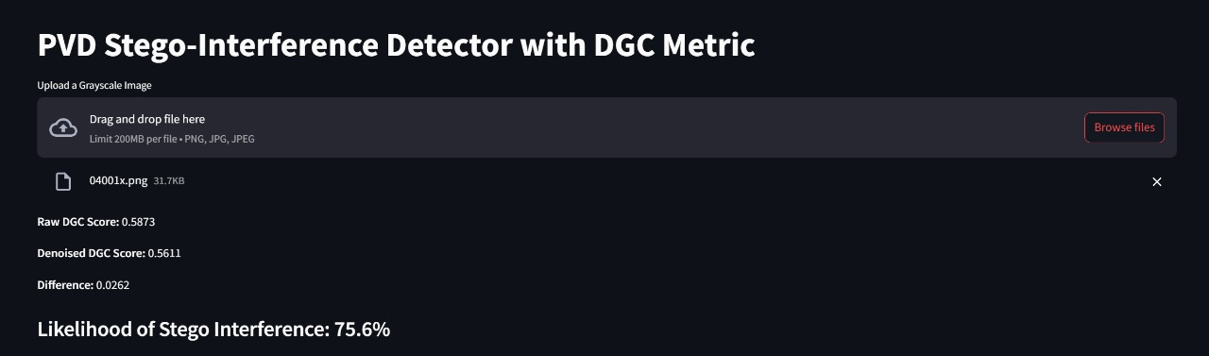
Implementation Results - Stego Image

Slide 18
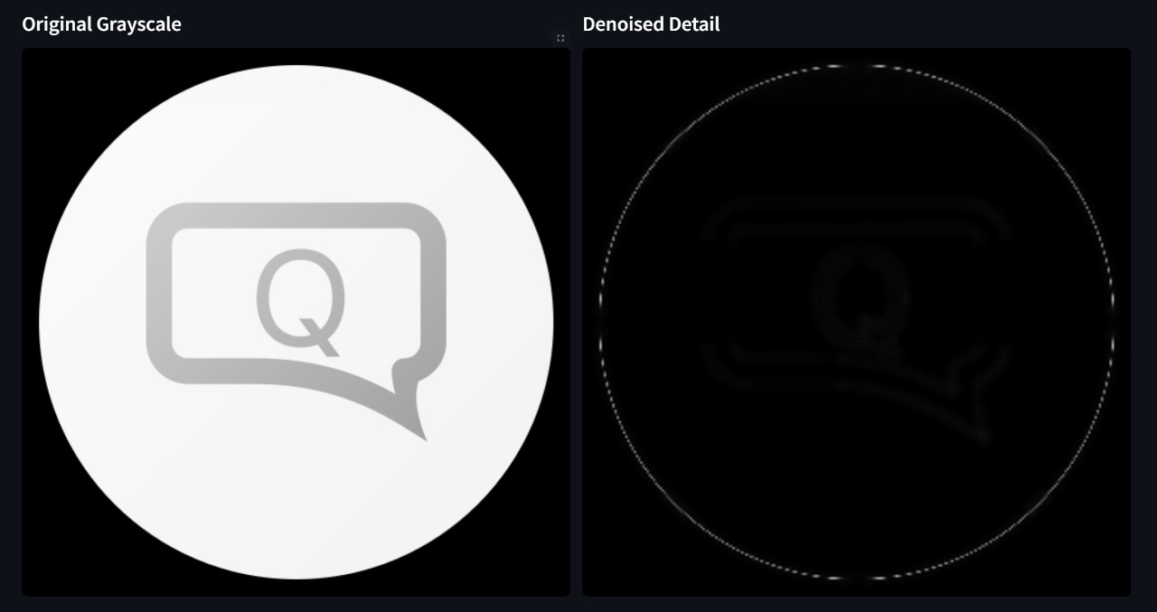
Implementation Results - Stego Image

Slide 19
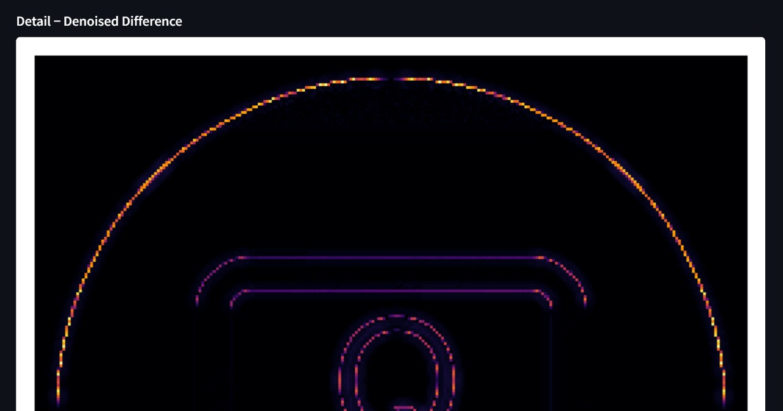
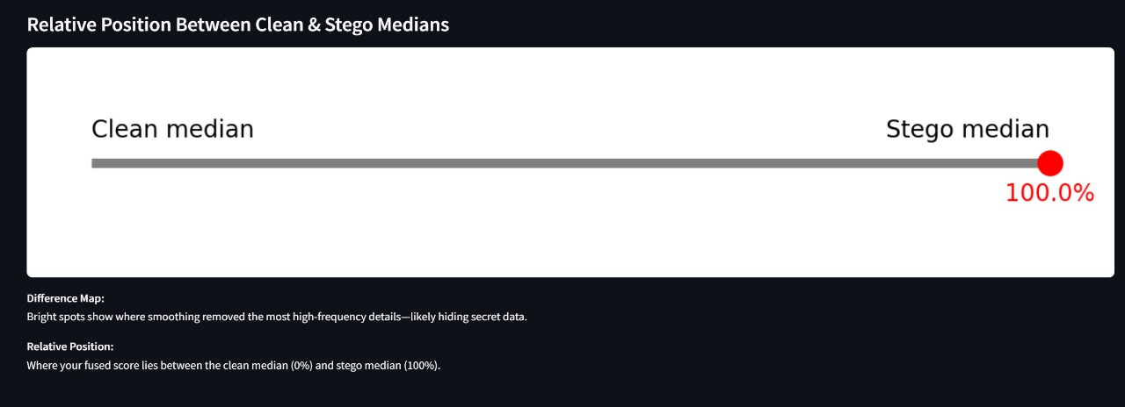
Implementation Results - Stego Image

Slide 20
Conclusion & Future Work
In conclusion, the Directional Gradient Coherence (DGC) metric effectively quantifies subtle angular disruptions in wavelet-based detail, enabling accurate detection of PVD steganography with interpretable visualizations.
Future work will extend evaluation to large‑scale color‑image datasets, assess robustness under diverse compression and noise conditions, explore alternative wavelet bases, and integrate machine learning classifiers for adaptive thresholding.
Optimization of computational performance and real‑time forensic plugin deployment form additional avenues for advancing this framework.

Slide 21
References
[1] C. Balasubramanian, S. Selvakumar, and S. Geetha, “High payload image steganography with reduced distortion using octonary pixel pairing scheme,” Multimedia Tools Appl., vol. 73, no. 3, pp. 2223–2245, 2014, doi:10.1007/s11042-013-1640-4.
[2] H. Zhang, T. Zhang, and H. Chen, “Revisiting weighted Stego-image Steganalysis for PVD steganography,” Multimedia Tools Appl., vol. 78, no. 5, pp. 5995–6013, Mar. 2019, doi:10.1007/S11042-018-6473-8.
[3] W.-B. Lin, T.-H. Lai, and K.-C. Chang, “Statistical feature-based steganalysis for pixel-value differencing steganography,” EURASIP J. Adv. Signal Process., May 2021, doi:10.1186/S13634-021-00797-5.
[4] G. Swain, “High Capacity Image Steganography Using Modified LSB Substitution and PVD against Pixel Difference Histogram Analysis,” Secur. Commun. Netw., Sep. 2018, doi:10.1155/2018/1505896.
[5] A. K. Sahu and G. Swain, “Multi-directional block based PVD and modulus function image steganography,” Alexandria Eng. J., vol. 64, pp. 1–12, May 2021, doi:10.1016/j.aej.2023.11.013.
[6] D. D. Shankar and A. S. Azhakath, “Minor blind feature based Steganalysis for calibrated JPEG images with SVM and SVM-PSO,” Multimedia Tools Appl., Jan. 2021, doi:10.1007/S11042-020-09820-7.

Slide 22
References
[7] M. G. Gireeshan, D. D. Shankar, and A. S. Azhakath, “Feature reduced blind steganalysis using DCT and spatial transform,” J. Ambient Intell. Humaniz. Comput., May 2021, doi:10.1007/S12652-020-02001-2.
[8] E. M. El-Alfy, “Detecting pixel-value differencing steganography using Levenberg–Marquardt neural network,” in Proc. IEEE CIDM, Apr. 2013, doi:10.1109/CIDM.2013.6597231.
[9] I.-H. Pan, K.-C. Liu, and C.-L. Liu, “Chi-Square Detection for PVD Steganography,” in Proc. IS3C, Nov. 2020, doi:10.1109/IS3C50286.2020.00015.
[10] W.-B. Lin, T.-H. Lai, and C.-L. Chou, “Chi-square-based steganalysis against MPVD,” Arab. J. Sci. Eng., Apr. 2021, doi:10.1007/S13369-021-05554-2.
[11] H. Zhang, T. Zhang, and H. Chen, “Variance Analysis of PVD Steganography,” in Proc. ACM, Mar. 2017, doi:10.1145/3058060.3058077.
[12] D. Progonov and M. Yarysh, “Analyzing the accuracy of detecting steganograms by adaptive methods,” East.-Eur. J. Enterp. Technol., Feb. 2022, doi:10.15587/1729-4061.2022.251350.

Slide 23
References
[13] A. O. Modupe, E. A. Adedoyin, and O. T. Adedeji, “Comparative Analysis of LSB, MSB and PVD Based Image Steganography,” Int. J. Res., Sep. 2021, doi:10.52403/IJRR.20210948.
[14] A. F. AbdelRazik, S. Saad, and A. S. Elsayed, “Image Steganography: A Comparative and Practical Study,” Int. J. Intell. Comput. Inf. Sci., Jun. 2024, doi:10.21608/ijicis.2024.290869.1337.
[15] A. Z. Abd Aziz, M. F. M. Sultan, and N. L. M. Zulkufli, “Image Steganography,” Int. J. Percept. Cogn. Comput., Jan. 2024, doi:10.31436/ijpcc.v10i1.449.
[16] M. A. Hameed, M. Hassaballah, and S. Aly, “Adaptive Steganography Based on HOG and PVD-LSB,” IEEE Access, Dec. 2019, doi:10.1109/ACCESS.2019.2960254.
[17] N. V. Dharwadkar et al., “A Medical Image Steganography Scheme Using PVD,” in Proc. Springer LNCS, 2023, doi:10.1007/978-981-99-1648-1_27.
[18] T. Halder, S. Karforma, and R. Mandal, “Data Hiding in E-Governance Using PVD,” Indian J. Sci. Technol., Jul. 2015, doi:10.17485/IJST/2015/V8I16/51269.

Slide 24
References
[19] C.-Y. Weng et al., “Adaptive Steganography Using Two-Tier PVD,” in Proc. Springer, Nov. 2017, doi:10.1007/978-981-10-6487-6_14.
[20] P. Chowdhuri et al., “Overlapped Pixel-Based Repeated PVD Scheme,” in Proc. Springer, 2020, doi:10.1007/978-981-15-4288-6_7.
[21] P. Yue et al., “Deceiving Steganalyzer Using Adversarial Noises,” in Proc. ACM, Sep. 2019, doi:10.1145/3364908.3364910.
[22] M. Rezaei et al., “STEGRT1: A Real-world Dataset for Steganalysis Evaluation,” in Proc. IEEE ICEE, Aug. 2020, doi:10.1109/ICEE50131.2020.9260644.

